Slide 1
RAPID MIXING & APPROXIMATE COUNTING
CS5330: Randomized Algorithms
Lecture 10
24/03/2020

Slide 2
Admin stuff
Week 10 problem set out
Optional problem set for Hashing & Markov chains out soon.
Midterm grades also out soon. Apologies for the delay.

Slide 3
Agenda
How do you show that a Markov chain reaches its stationary distribution fast? We look at one technique: coupling.
An important application of approximate sampling: approximate counting

Slide 4
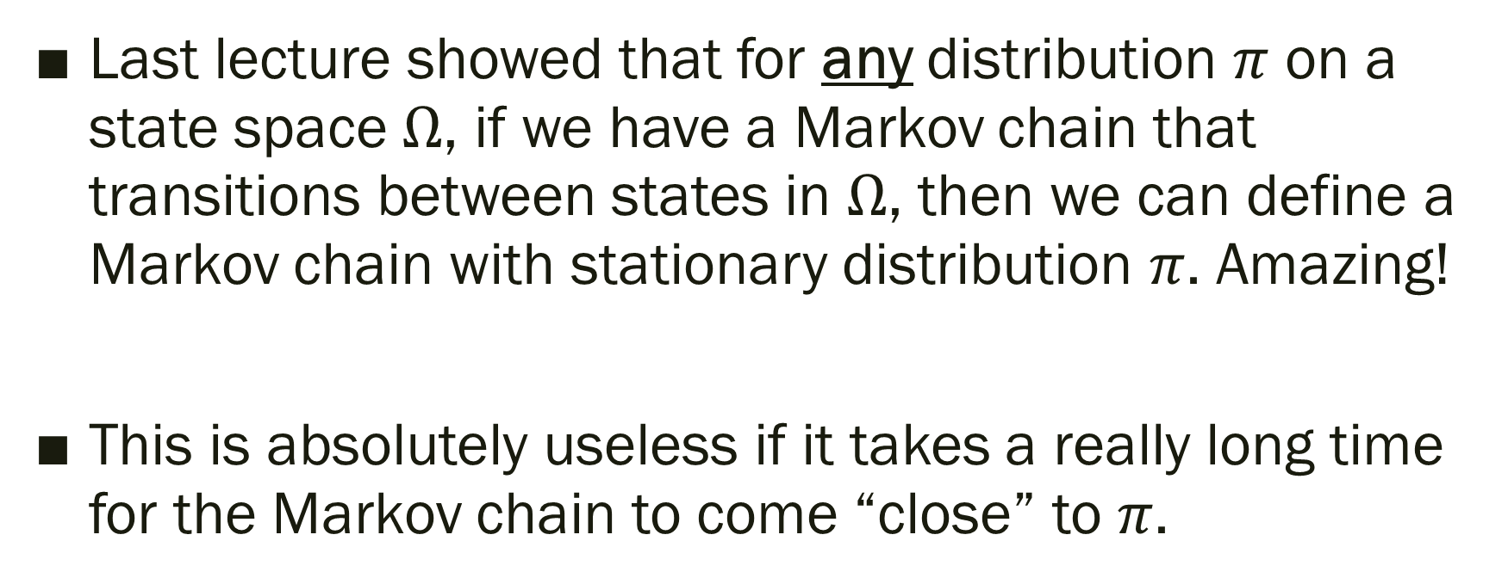
Setup
Last lecture showed that for any distribution $π$ on a state space $Ω$, if we have a Markov chain that transitions between states in $Ω$, then we can define a Markov chain with stationary distribution $π$. Amazing!
This is absolutely useless if it takes a really long time for the Markov chain to come “close” to $π$.

Slide 5
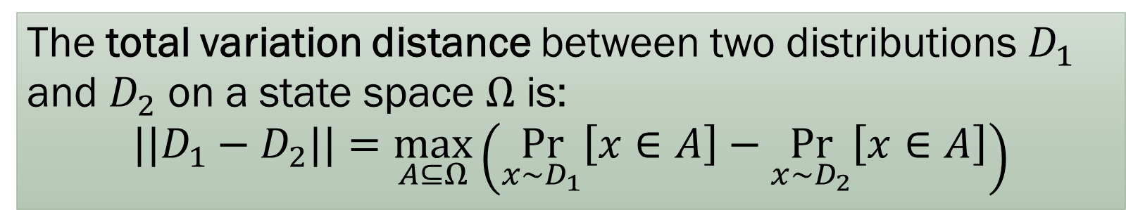
What is “close”?
The total variation distance between two distributions $D_{1}$ and $D_{2}$ on a state space $Ω$ is:
$$||D_{1}−D_{2}||=\max_{A⊆Ω}\left(\underset{x∼D_{1}}{Pr}\left[x∈A\right]−\underset{x∼D_{2}}{Pr}\left[x∈A\right]\right)$$
Symmetric: $||D_{1}−D_{2}||=||D_{2}−D_{1}||$
A very strong notion of closeness and satisfies many useful properties.

Slide 6
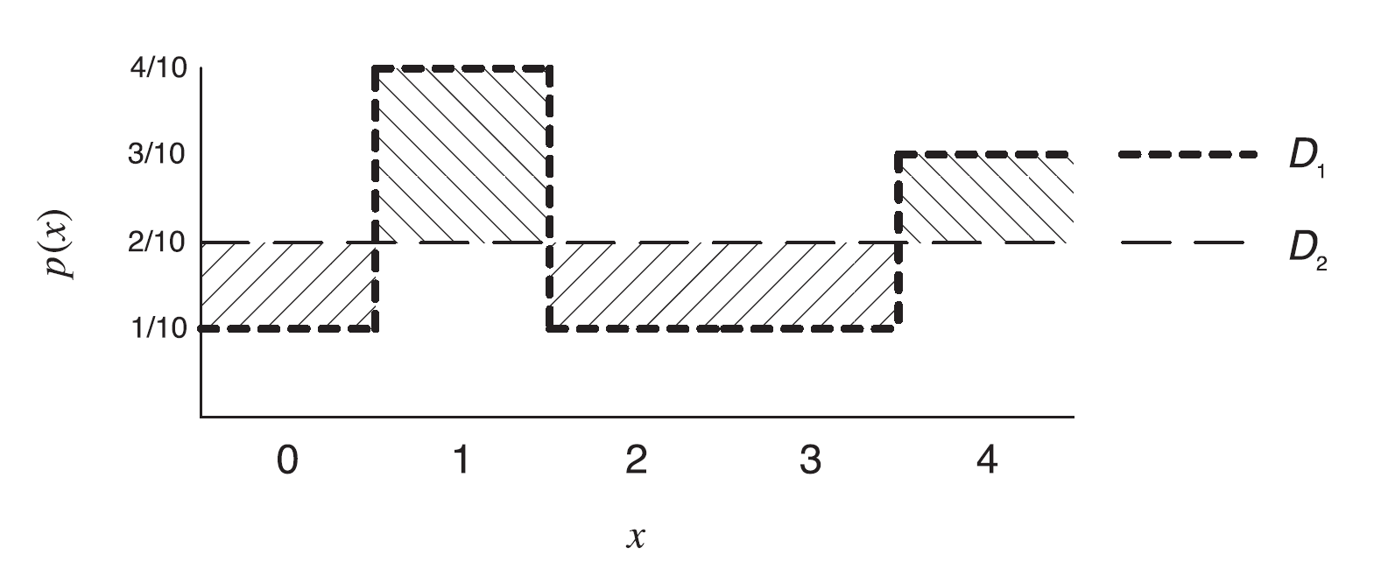
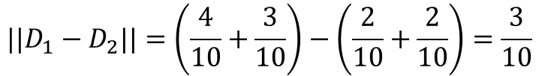
Example
$$||D_{1}−D_{2}||=\left(\frac{4}{10}+\frac{3}{10}\right)−\left(\frac{2}{10}+\frac{2}{10}\right)=\frac{3}{10}$$

Slide 7
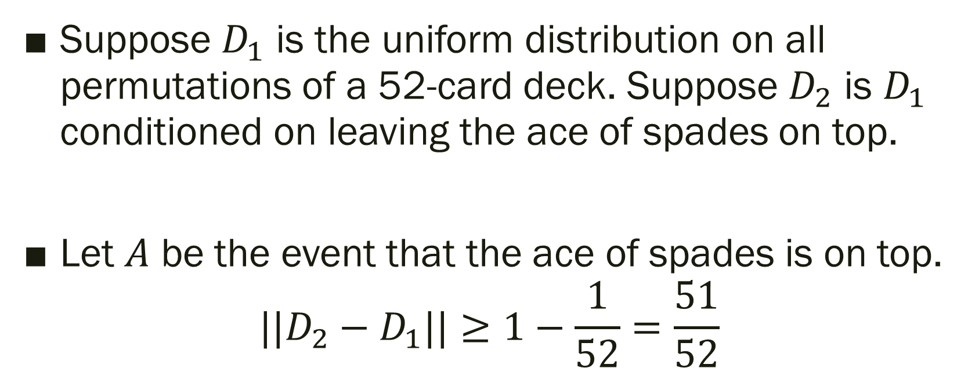
Example
Suppose $D_{1}$ is the uniform distribution on all permutations of a 52-card deck. Suppose $D_{2}$ is $D_{1}$ conditioned on leaving the ace of spades on top.
Let $A$ be the event that the ace of spades is on top.
$$||D_{2}−D_{1}||≥1−\frac{1}{52}=\frac{51}{52}$$

Slide 8
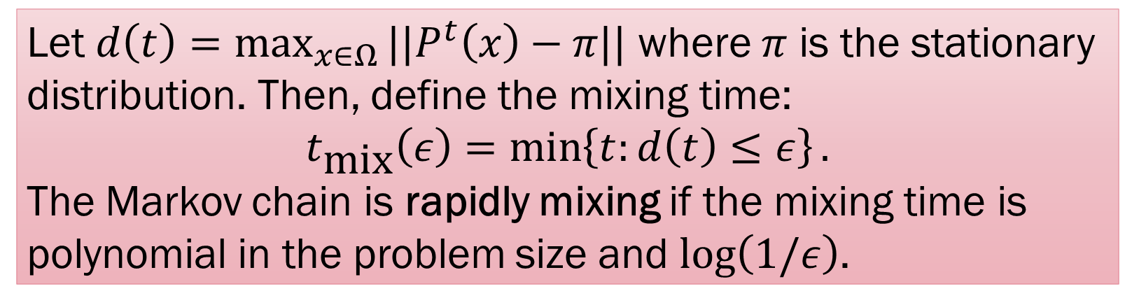
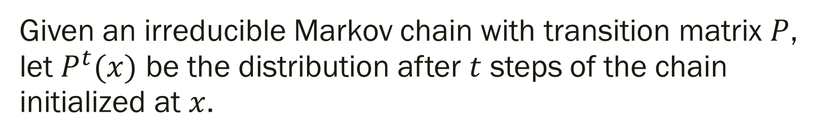
Mixing Time
Given an irreducible Markov chain with transition matrix $P$, let $P^{t}(x)$ be the distribution after $t$ steps of the chain initialized at $x$.
Let $d\left(t\right)=\max_{x∈Ω}{||P^{t}\left(x\right)−π||}$ where $π$ is the stationary distribution. Then, define the mixing time:
$$t_{\text{mix}}\left(ε\right)=\min\left\{t:d\left(t\right)≤ε\right\}.$$
The Markov chain is rapidly mixing if the mixing time is polynomial in the problem size and $\log\left(1/ε\right)$.

Slide 9
How to show rapid mixing
Many techniques known in the literature: canonical paths, conductance, comparison methods, statistical physics, Poincare-type inequalities, log-Sobolev inequalities, …
We look at one simple technique, coupling, which is nevertheless pretty powerful

Slide 10
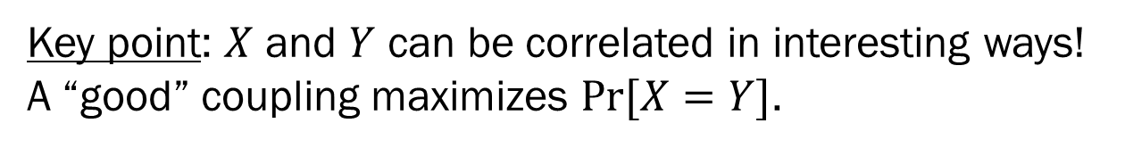
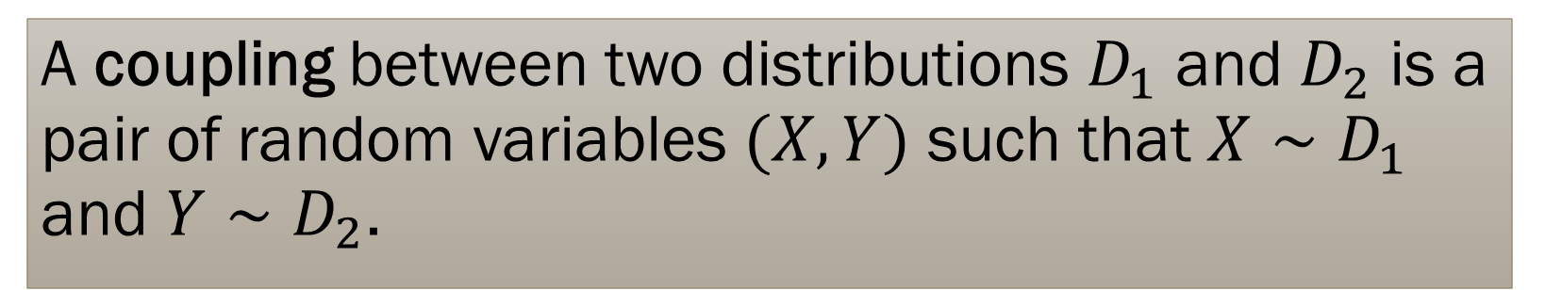
Coupling
A coupling between two distributions $D_{1}$ and $D_{2}$ is a pair of random variables $(X,Y)$ such that $X∼D_{1}$ and $Y∼D_{2}$.
Key point: $X$ and $Y$ can be correlated in interesting ways! A “good” coupling maximizes $Pr[X=Y]$.

Slide 11

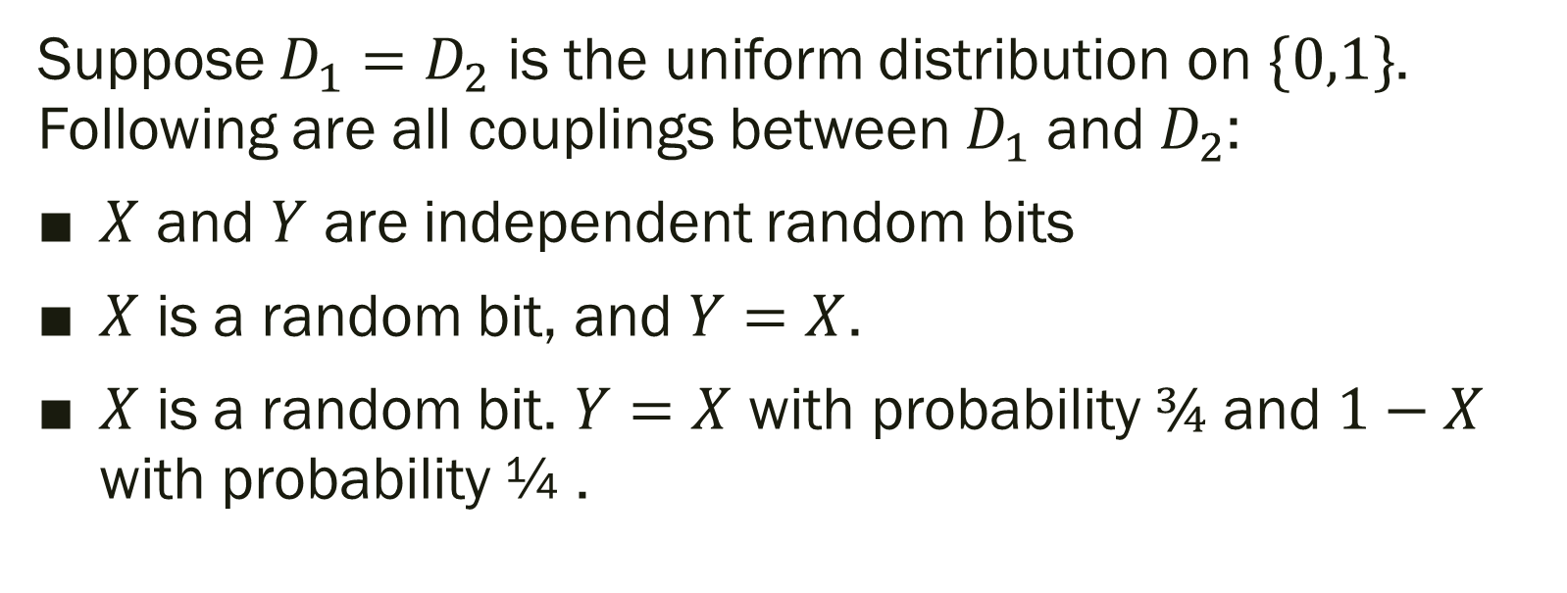
Examples
Suppose $D_{1}=D_{2}$ is the uniform distribution on $\{0,1\}$. Following are all couplings between $D_{1}$ and $D_{2}$:
$X$ and $Y$ are independent random bits
$X$ is a random bit, and $Y=X$.
$X$ is a random bit. $Y=X$ with probability $¾$ and $1−X$ with probability ¼ .

Slide 12
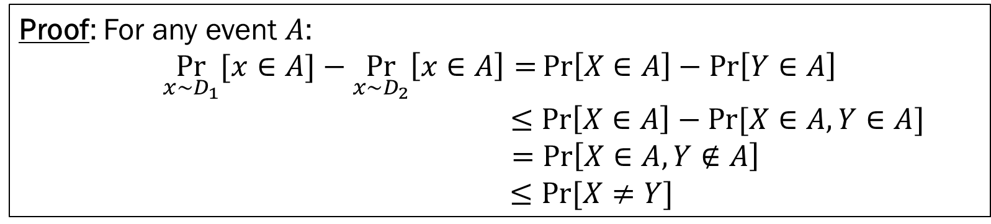
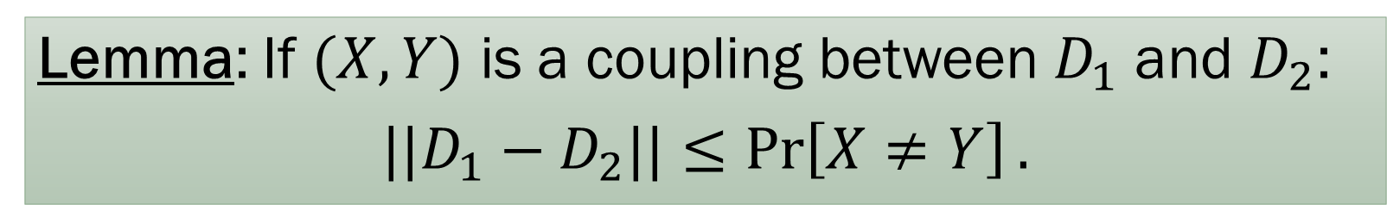
Coupling Lemma
Lemma: If $(X,Y)$ is a coupling between $D_{1}$ and $D_{2}$:
$||D_{1}−D_{2}||≤\operatorname{Pr}\left[X≠Y\right].$
Proof: For any event $A$:
$$\underset{x∼D_{1}}{Pr}{[x∈A]}−\underset{x∼D_{2}}{Pr}\left[x∈A\right]=\operatorname{Pr}\left[X∈A\right]−\operatorname{Pr}\left[Y∈A\right]$$
$$≤\operatorname{Pr}\left[X∈A\right]−Pr⁡[X∈A, Y∈A]$$
$$=\operatorname{Pr}\left[X∈A, Y∉A\right]$$
$$≤Pr⁡[X≠Y]$$

Slide 13
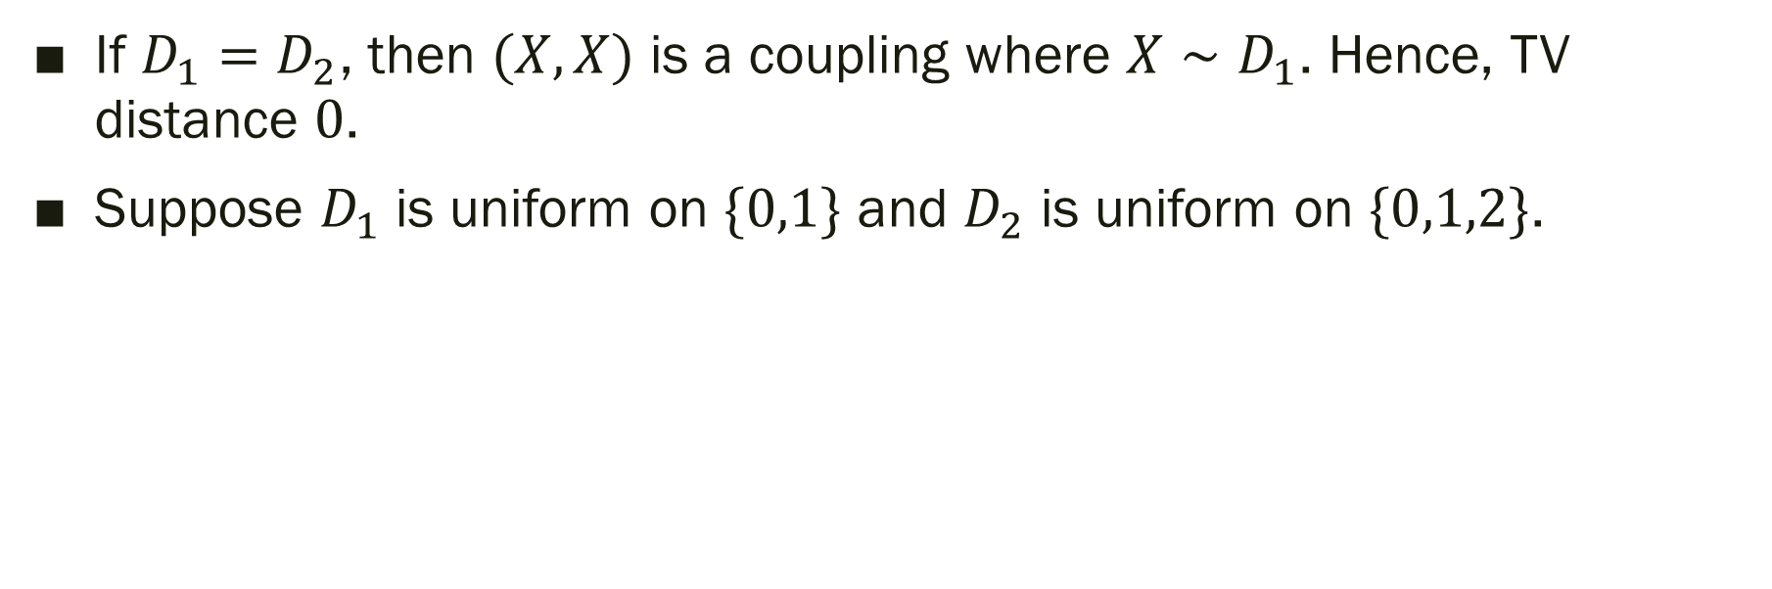
Examples
If $D_{1}=D_{2}$, then $(X,X)$ is a coupling where $X∼D_{1}$. Hence, TV distance $0$.
Suppose $D_{1}$ is uniform on $\{0,1\}$ and $D_{2}$ is uniform on $\{0,1,2\}$.

Slide 14
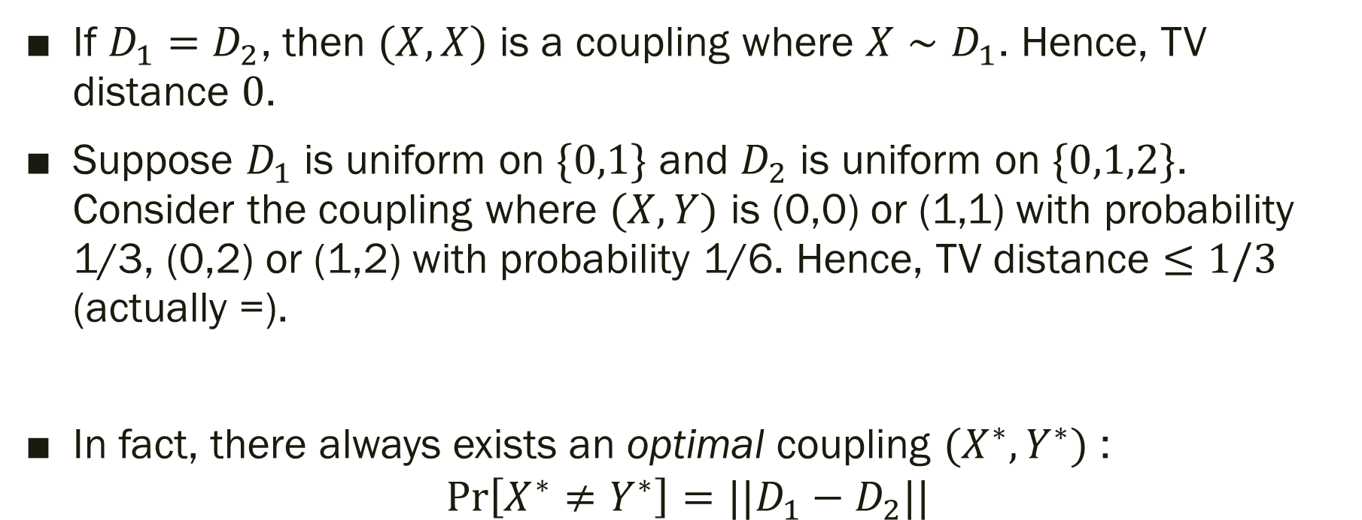
Examples
If $D_{1}=D_{2}$, then $(X,X)$ is a coupling where $X∼D_{1}$. Hence, TV distance $0$.
Suppose $D_{1}$ is uniform on $\{0,1\}$ and $D_{2}$ is uniform on $\{0,1,2\}$. Consider the coupling where $(X,Y)$ is (0,0) or (1,1) with probability 1/3, (0,2) or (1,2) with probability 1/6. Hence, TV distance $≤1/3$ (actually =).
In fact, there always exists an optimal coupling $(X^{∗},Y^{∗})$ :
$$\operatorname{Pr}\left[X^{∗}≠Y^{∗}\right]=||D_{1}−D_{2}||$$

Slide 15
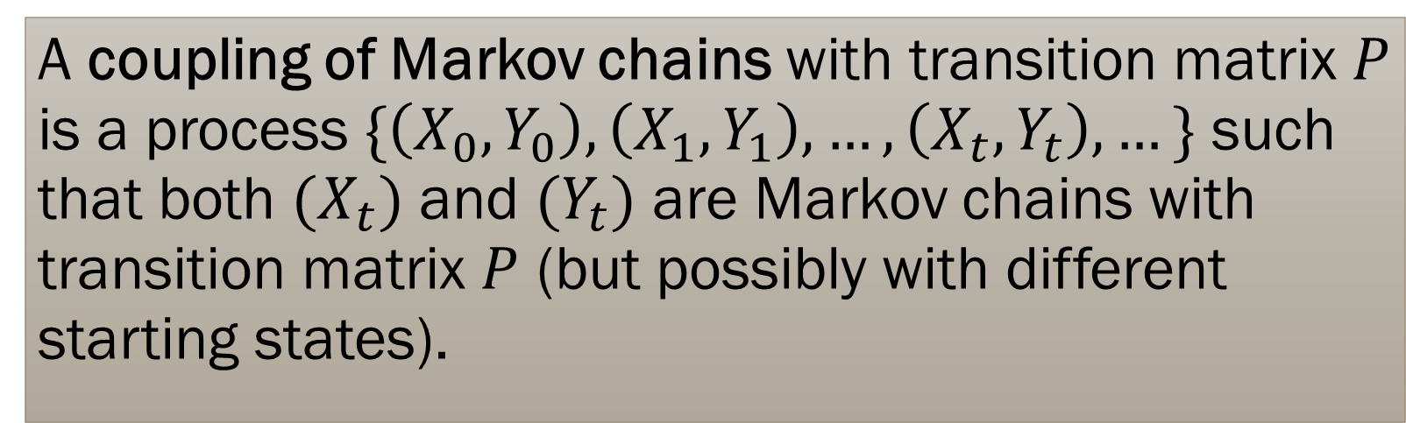
Couplings of Markov Chains
A coupling of Markov chains with transition matrix $P$ is a process $\{\left(X_{0},Y_{0}\right),\left(X_{1},Y_{1}\right), …, \left(X_{t},Y_{t}\right), …\}$ such that both $(X_{t})$ and $(Y_{t})$ are Markov chains with transition matrix $P$ (but possibly with different starting states).
We can assume without loss of generality that once $X_{T}=Y_{T}$, $X_{s}=Y_{s}$ for all $s>T$. We say the chains are coupled after $T$ steps.

Slide 16
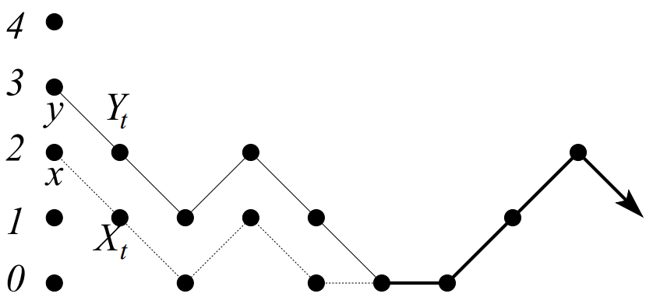
Example
Coupling of random walk on the line where at each interior point, you go up or down with equal probability and at a boundary, you stick with probability ½ and move inwards with probability ½.

Slide 17
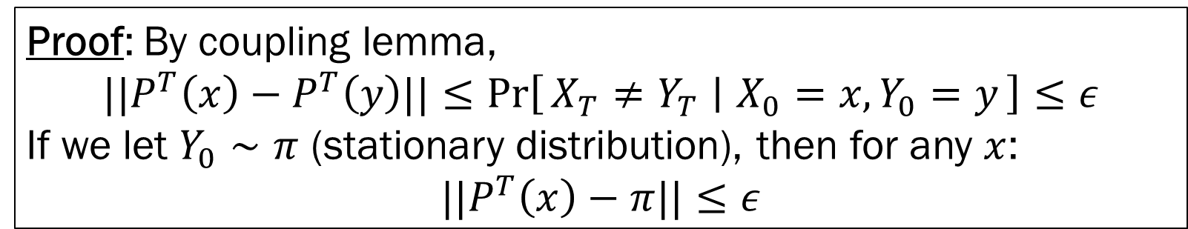
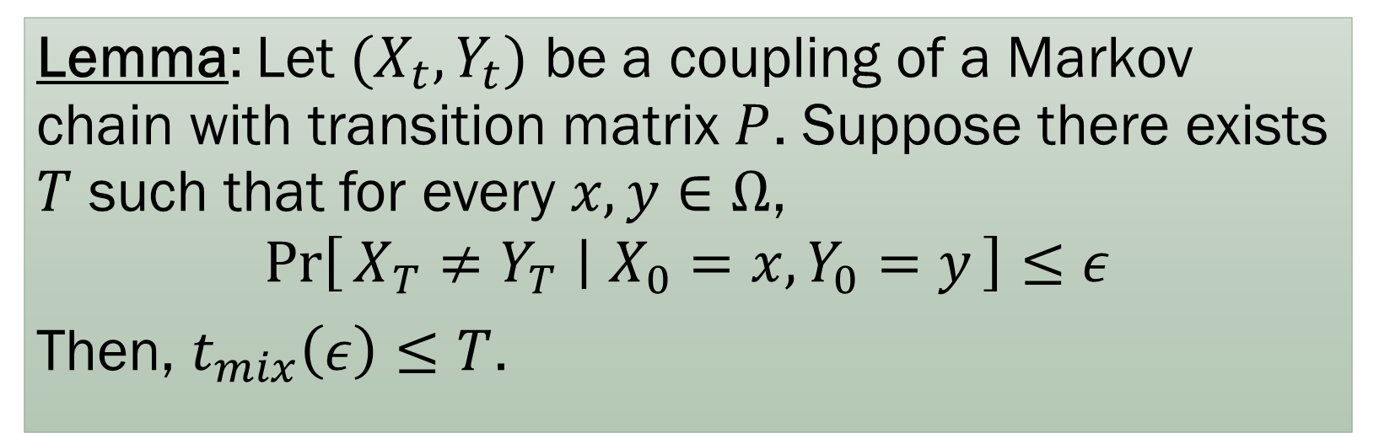
Markov Chain Coupling Lemma
Lemma: Let $(X_{t},Y_{t})$ be a coupling of a Markov chain with transition matrix $P$. Suppose there exists $T$ such that for every $x,y∈Ω$,
$$\operatorname{Pr}\left[X_{T}≠Y_{T} ∣ X_{0}=x, Y_{0}=y\right]≤ε$$
Then, $t_{mix}\left(ε\right)≤T$.
Proof: By coupling lemma,
$$||P^{T}\left(x\right)−P^{T}\left(y\right)||≤\operatorname{Pr}\left[X_{T}≠Y_{T} ∣ X_{0}=x, Y_{0}=y\right]≤ε$$
If we let $Y_{0}∼π$ (stationary distribution), then for any $x$:
$$||P^{T}\left(x\right)−π||≤ε$$

Slide 18
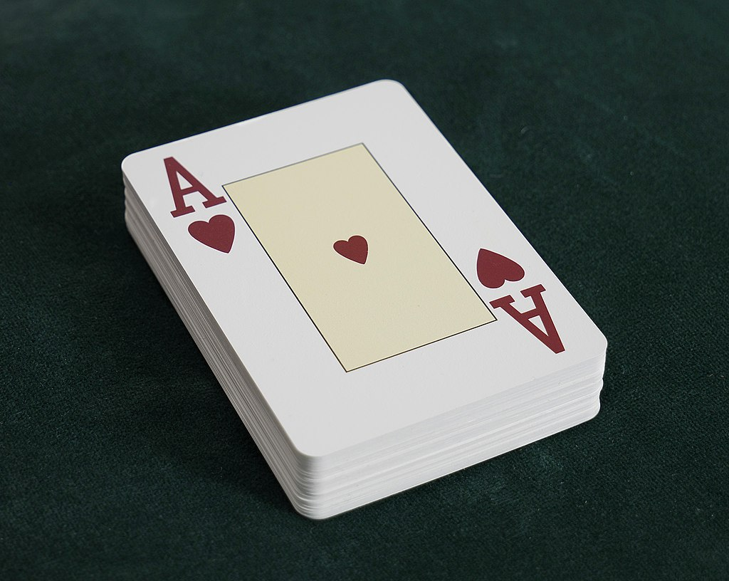
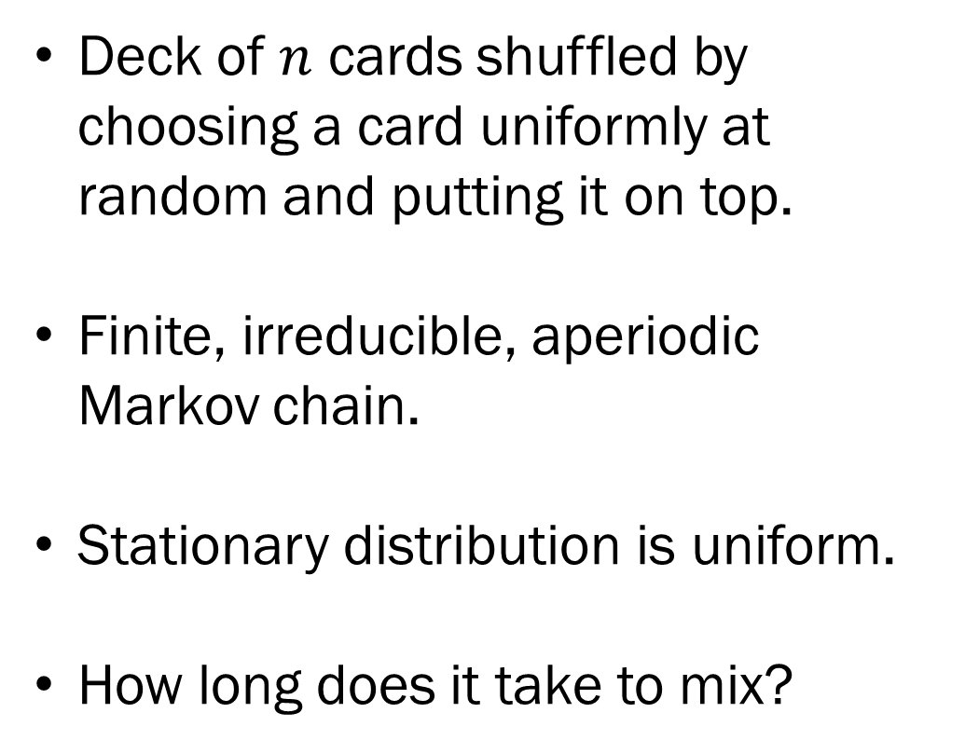
Example: Card Shuffling
Deck of $n$ cards shuffled by choosing a card uniformly at random and putting it on top.
Finite, irreducible, aperiodic Markov chain.
Stationary distribution is uniform.
How long does it take to mix?

Slide 19
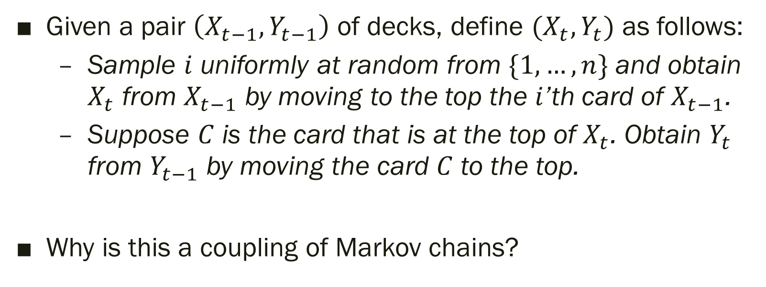
Example: Card Shuffling
Given a pair $\left(X_{t−1}, Y_{t−1}\right)$ of decks, define $(X_{t},Y_{t})$ as follows:
  Sample $i$ uniformly at random from $\{1, …, n\}$ and obtain $X_{t}$ from $X_{t−1}$ by moving to the top the $i$’th card of $X_{t−1}$.
  Suppose $C$ is the card that is at the top of $X_{t}$. Obtain $Y_{t}$ from $Y_{t−1}$ by moving the card $C$ to the top.
Why is this a coupling of Markov chains?

Slide 20
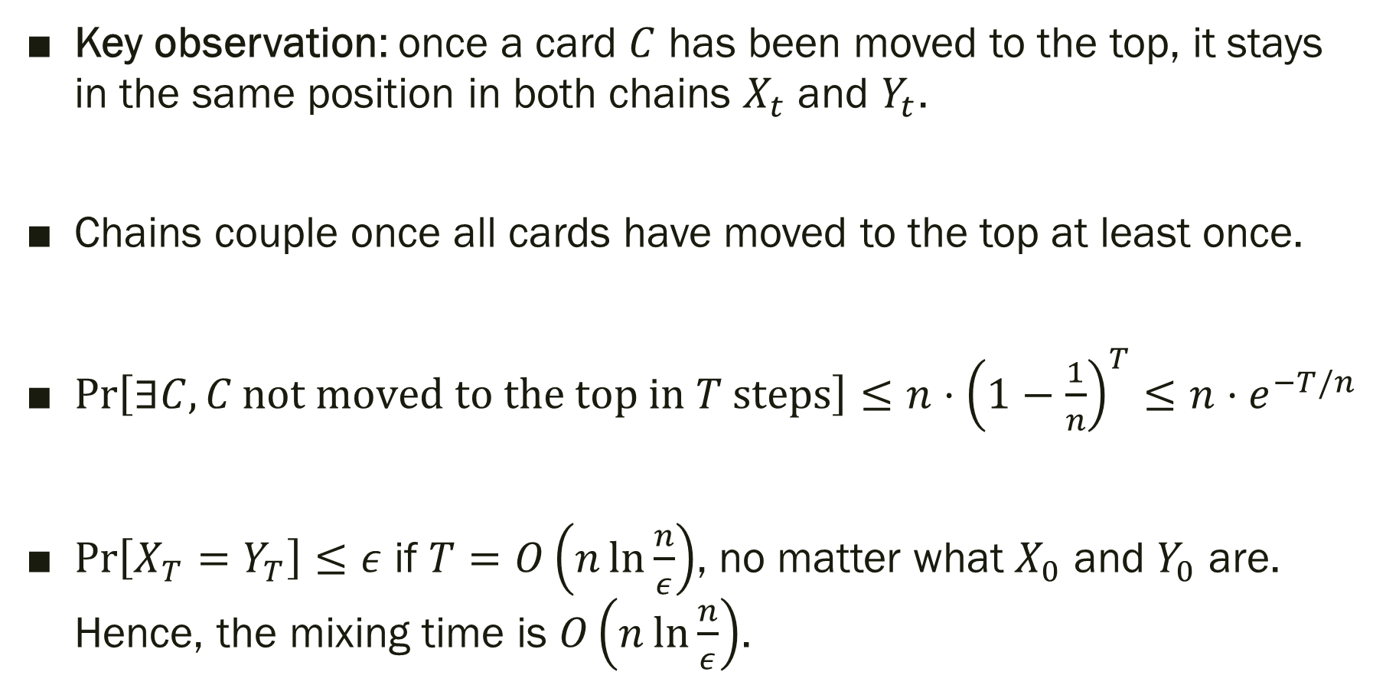
Example: Card Shuffling
Key observation: once a card $C$ has been moved to the top, it stays in the same position in both chains $X_{t}$ and $Y_{t}$.
Chains couple once all cards have moved to the top at least once.
$\operatorname{Pr}\left[∃C, C \text{not} \text{moved} \text{to} \text{the} \text{top} \text{in} T \text{steps}\right]≤n⋅{\left(1−\frac{1}{n}\right)}^{T}≤n⋅e^{−T/n}$
$\operatorname{Pr}\left[X_{T}=Y_{T}\right]≤ε$ if $T=O\left(n\ln{\frac{n}{ε}}\right)$, no matter what $X_{0}$ and $Y_{0}$ are. Hence, the mixing time is $O\left(n\ln{\frac{n}{ε}}\right)$.

Slide 21
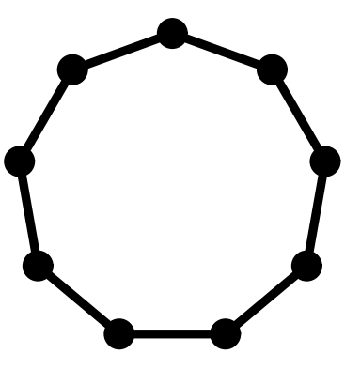
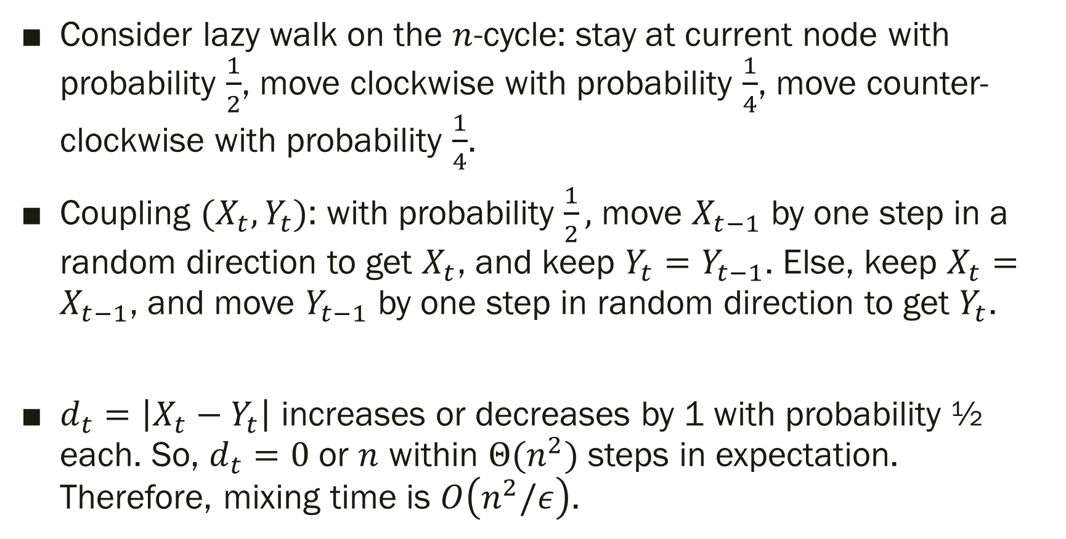
Example: Lazy walk on the cycle
Consider lazy walk on the $n$-cycle: stay at current node with probability $\frac{1}{2}$, move clockwise with probability $\frac{1}{4}$, move counter-clockwise with probability $\frac{1}{4}$.
Coupling $(X_{t},Y_{t})$: with probability $\frac{1}{2},$ move $X_{t−1}$ by one step in a random direction to get $X_{t}$, and keep $Y_{t}=Y_{t−1}$. Else, keep $X_{t}=X_{t−1}$, and move $Y_{t−1}$ by one step in random direction to get $Y_{t}$.
$d_{t}=\left|X_{t}−Y_{t}\right|$ increases or decreases by 1 with probability ½ each. So, $d_{t}=0$ or $n$ within $Θ(n^{2})$ steps in expectation. Therefore, mixing time is $O\left(n^{2}/ε\right)$.

Slide 22
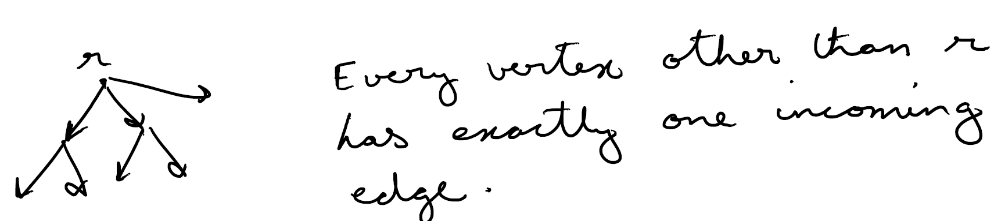
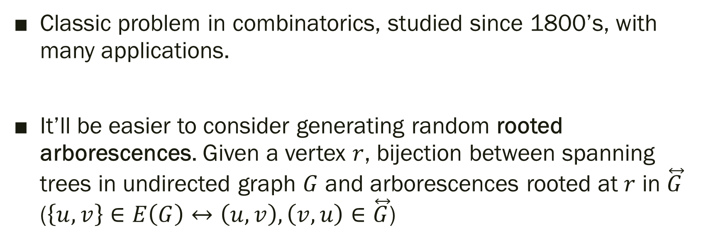
Example: Random Spanning Trees
Classic problem in combinatorics, studied since 1800’s, with many applications.
It’ll be easier to consider generating random rooted arborescences. Given a vertex $r$, bijection between spanning trees in undirected graph $G$ and arborescences rooted at $r$ in $\overset{⃡}{G}$ ($\left\{u,v\right\}∈E\left(G\right)↔\left(u,v\right), \left(v,u\right)∈\overset{⃡}{G}$)

Slide 23



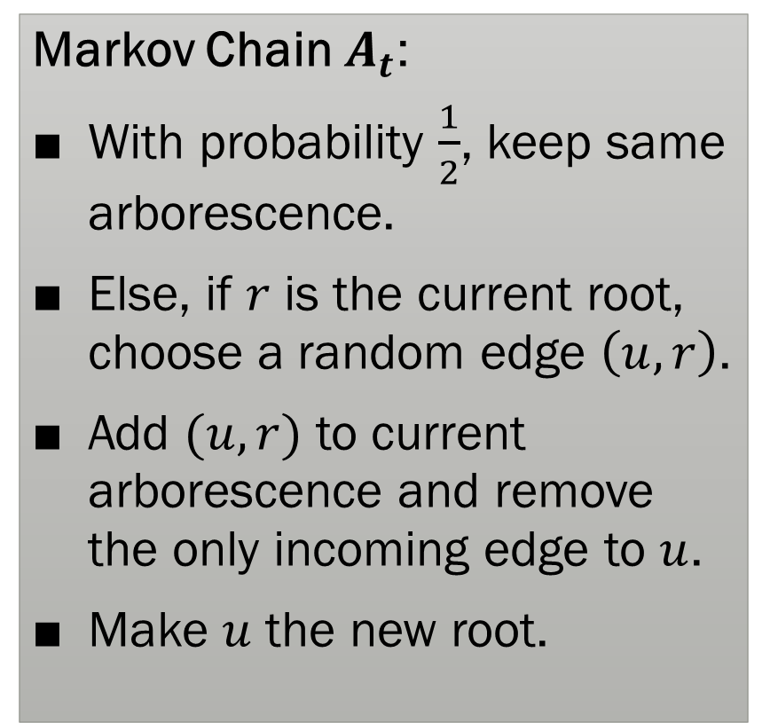



Example: Random Rooted Arborescences
$$r$$
Markov Chain $A_{t}$:
With probability $\frac{1}{2}$, keep same arborescence.
Else, if $r$ is the current root, choose a random edge $\left(u,r\right)$.
Add $(u,r)$ to current arborescence and remove the only incoming edge to $u$.
Make $u$ the new root.
$$A_{t−1}$$
$$u$$
$$r$$
$$A_{t}$$
$$u$$

Slide 24
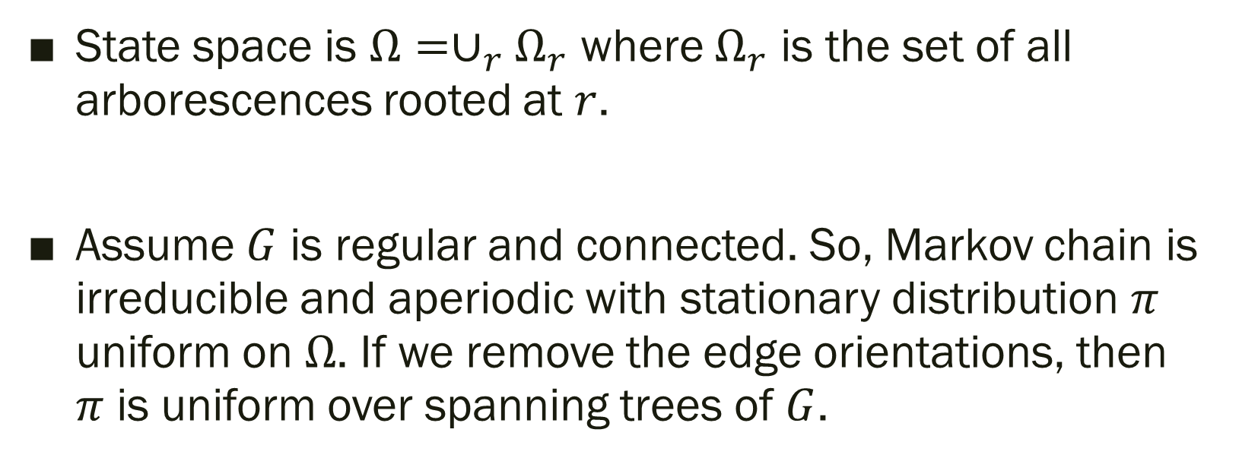
Example: Random Rooted Arborescences
State space is $Ω=∪_{r}Ω_{r}$ where $Ω_{r}$ is the set of all arborescences rooted at $r$.
Assume $G$ is regular and connected. So, Markov chain is irreducible and aperiodic with stationary distribution $π$ uniform on $Ω$. If we remove the edge orientations, then $π$ is uniform over spanning trees of $G$.

Slide 25
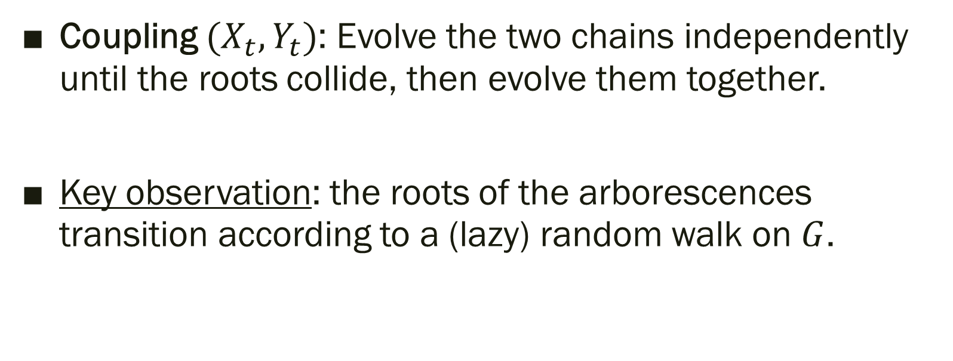
Example: Random Rooted Arborescences
Coupling $(X_{t}, Y_{t})$: Evolve the two chains independently until the roots collide, then evolve them together.
Key observation: the roots of the arborescences transition according to a (lazy) random walk on $G$.

Slide 26
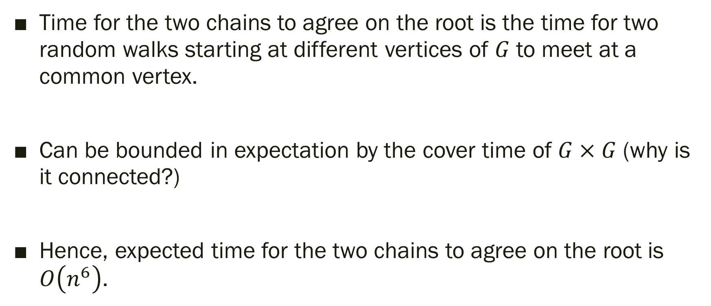
Example: Random Rooted Arborescences
Time for the two chains to agree on the root is the time for two random walks starting at different vertices of $G$ to meet at a common vertex.
Can be bounded in expectation by the cover time of $G×G$ (why is it connected?)
Hence, expected time for the two chains to agree on the root is $O\left(n^{6}\right)$.

Slide 27
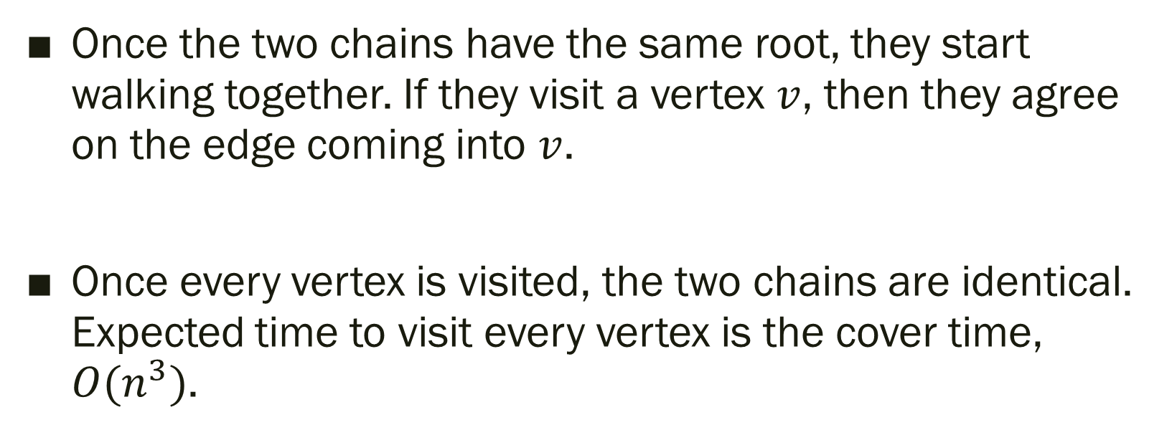
Example: Random Rooted Arborescences
Once the two chains have the same root, they start walking together. If they visit a vertex $v$, then they agree on the edge coming into $v$.
Once every vertex is visited, the two chains are identical. Expected time to visit every vertex is the cover time, $O(n^{3})$.

Slide 28
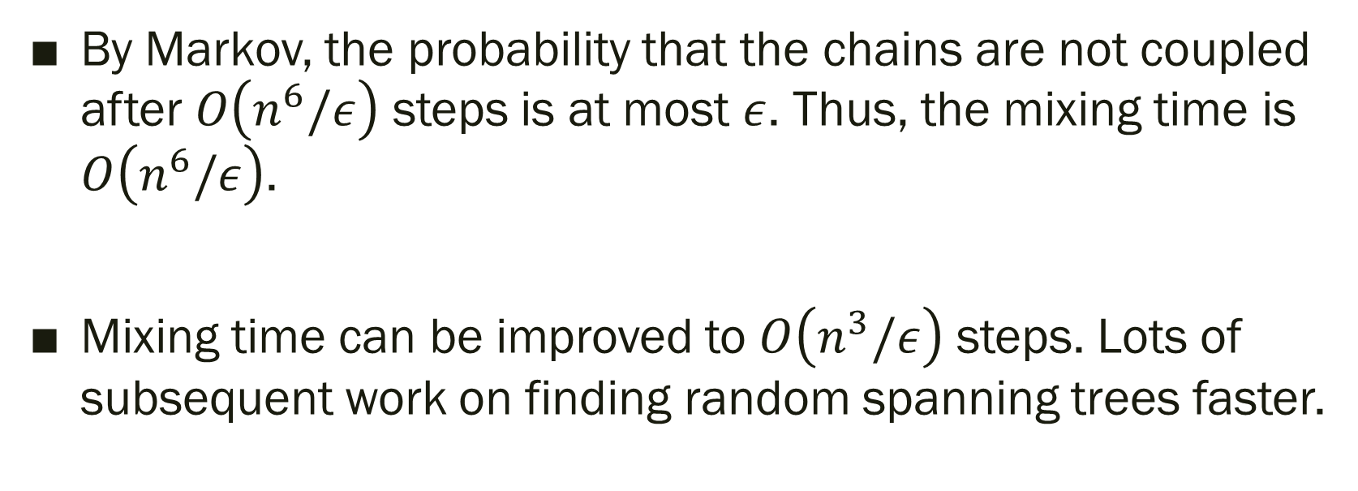
Example: Random Rooted Arborescences
By Markov, the probability that the chains are not coupled after $O\left(n^{6}/ε\right)$ steps is at most $ε$. Thus, the mixing time is $O\left(n^{6}/ε\right)$.
Mixing time can be improved to $O\left(n^{3}/ε\right)$ steps. Lots of subsequent work on finding random spanning trees faster.

Slide 29
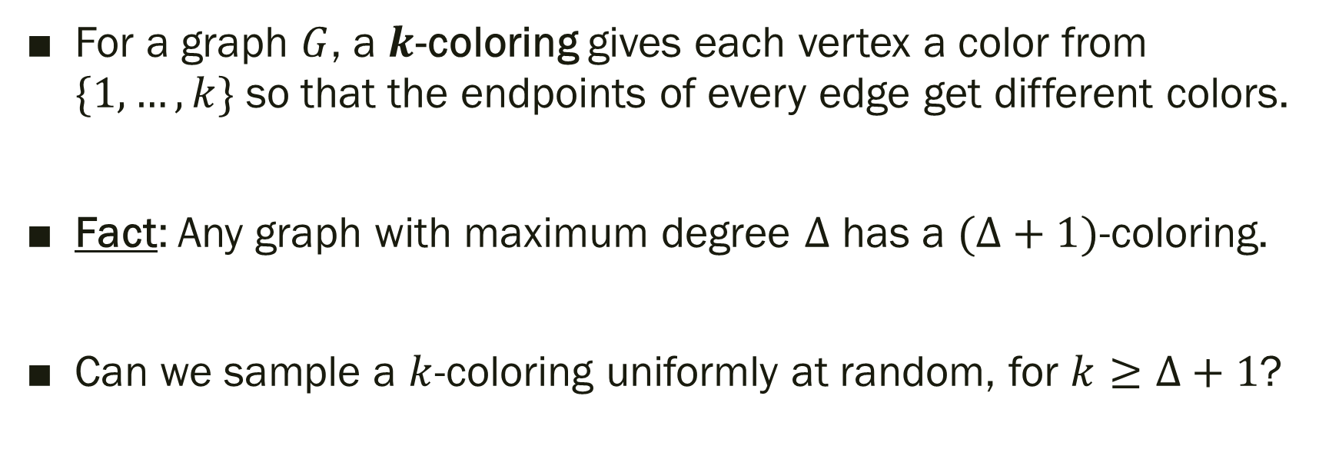

Example: Random $k$-colorings
For a graph $G$, a $k$-coloring gives each vertex a color from $\{1,…, k\}$ so that the endpoints of every edge get different colors.
Fact: Any graph with maximum degree $Δ$ has a $(Δ+1)$-coloring.
Can we sample a $k$-coloring uniformly at random, for $k≥Δ+1$?

Slide 30
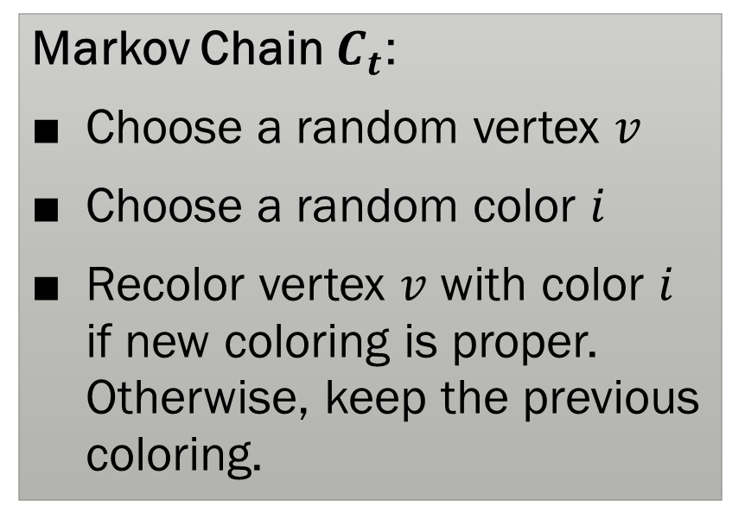

Example: Random $k$-colorings
Markov Chain $C_{t}$:
Choose a random vertex $v$
Choose a random color $i$
Recolor vertex $v$ with color $i$ if new coloring is proper. Otherwise, keep the previous coloring.
Blue

Slide 31
Example: Random $k$-colorings
Markov Chain $C_{t}$:
Choose a random vertex $v$
Choose a random color $i$
Recolor vertex $v$ with color $i$ if new coloring is proper. Otherwise, keep the previous coloring.
Red

Slide 32
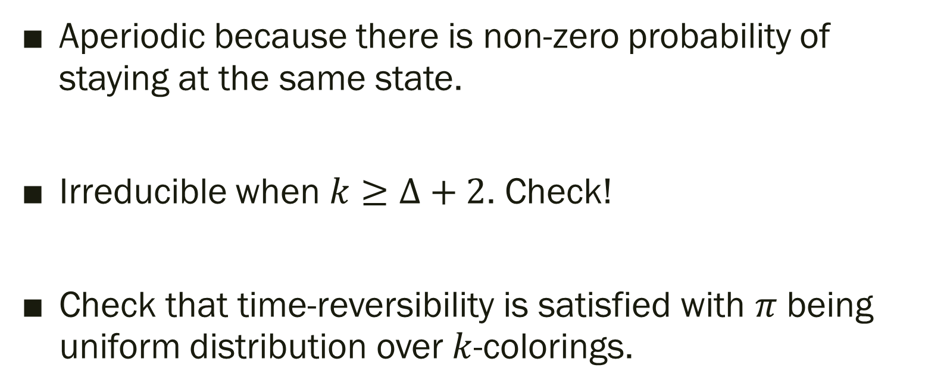
Example: Random $k$-colorings
Aperiodic because there is non-zero probability of staying at the same state.
Irreducible when $k≥Δ+2$. Check!
Check that time-reversibility is satisfied with $π$ being uniform distribution over $k$-colorings.

Slide 33
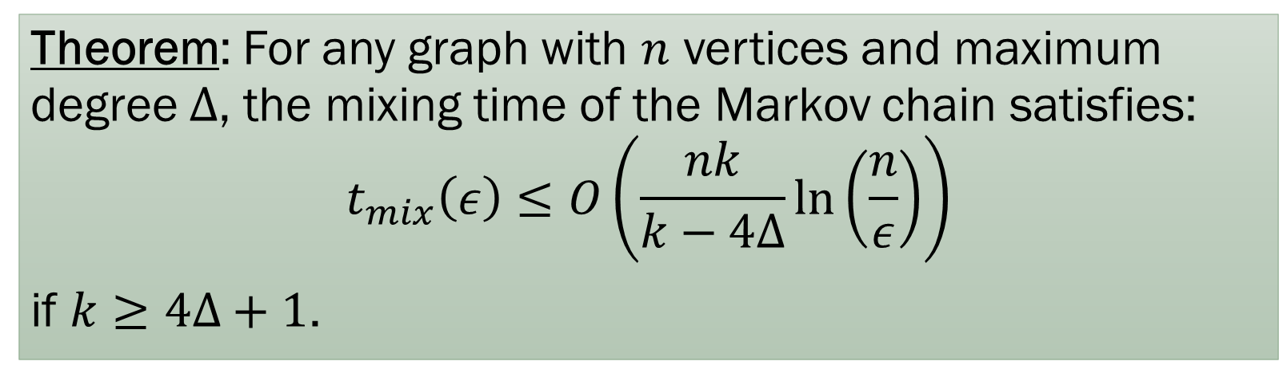
Example: Random $k$-colorings
Theorem: For any graph with $n$ vertices and maximum degree $Δ$, the mixing time of the Markov chain satisfies:
$$t_{mix}\left(ε\right)≤O\left(\frac{nk}{k−4Δ}\ln\left(\frac{n}{ε}\right)\right)$$
if $k≥4Δ+1$.

Slide 34
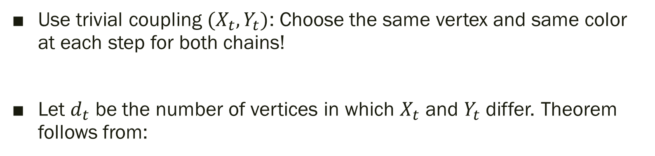

Example: Random $k$-colorings
Use trivial coupling $(X_{t},Y_{t})$: Choose the same vertex and same color at each step for both chains!
Let $d_{t}$ be the number of vertices in which $X_{t}$ and $Y_{t}$ differ. Theorem follows from:
Lemma: If $k≥4Δ+1$:
$$𝔼\left[d_{t+1}\right]≤𝔼\left[d_{t}\right]⋅\left(1−\frac{k−4Δ}{nk}\right)$$

Slide 35

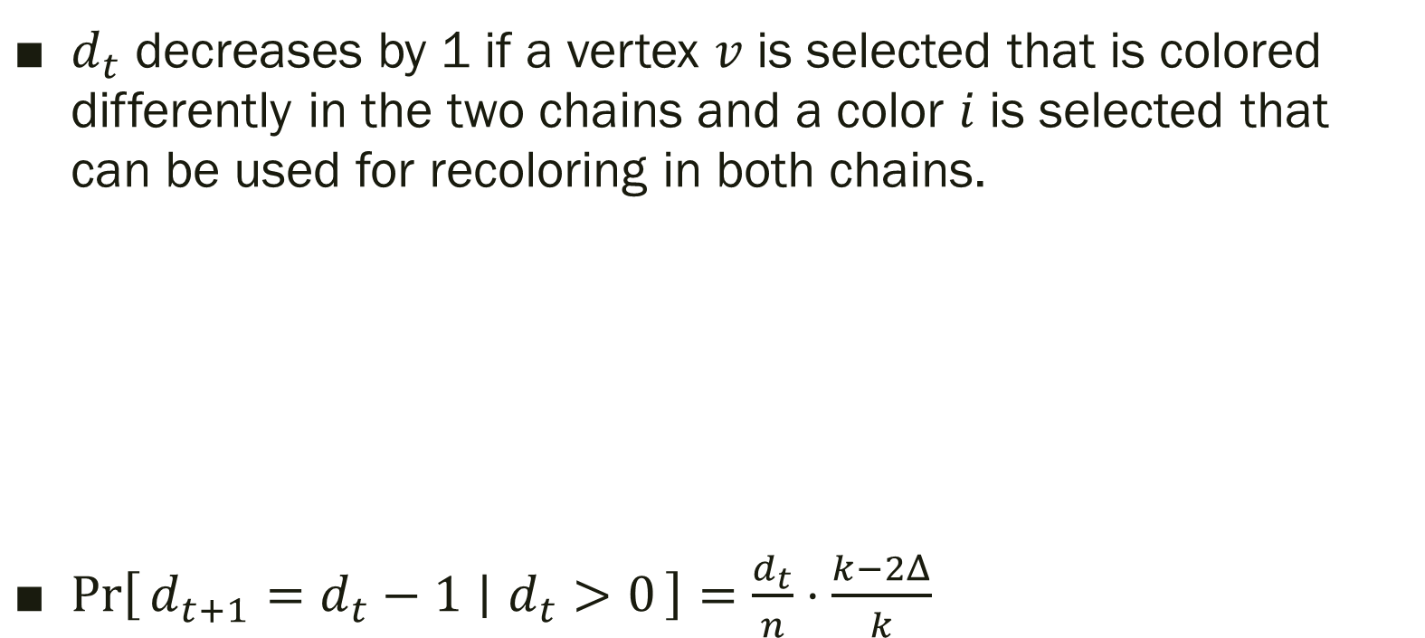





Example: Random $k$-colorings
$d_{t}$ decreases by 1 if a vertex $v$ is selected that is colored differently in the two chains and a color $i$ is selected that can be used for recoloring in both chains.
$\operatorname{Pr}\left[d_{t+1}=d_{t}−1 ∣ d_{t}>0\right]=\frac{d_{t}}{n}⋅\frac{k−2Δ}{k}$
Yellow
$$X_{t}$$
$$Y_{t}$$
$$X_{t+1}$$
$$Y_{t+1}$$

Slide 36

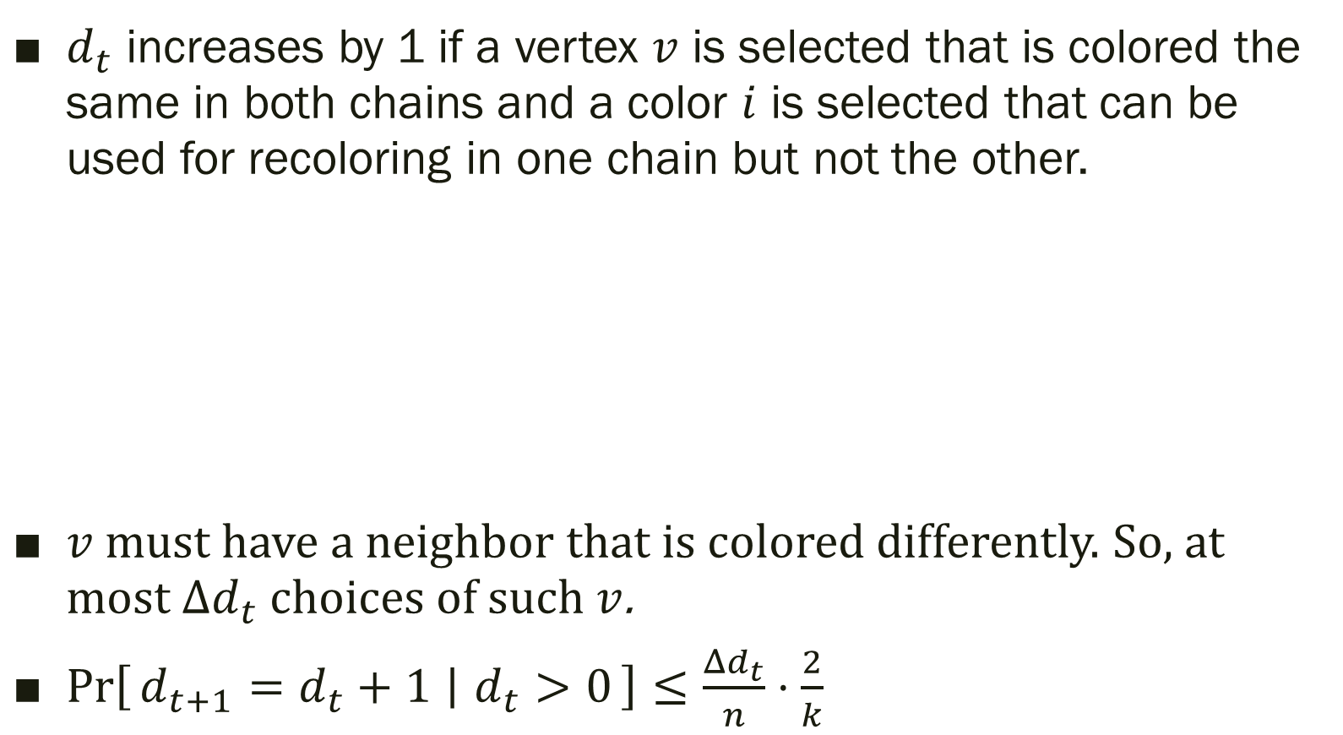



Example: Random $k$-colorings
$d_{t}$ increases by 1 if a vertex $v$ is selected that is colored the same in both chains and a color $i$ is selected that can be used for recoloring in one chain but not the other.
$v$ must have a neighbor that is colored differently. So, at most $Δd_{t}$ choices of such $v$.
$\operatorname{Pr}\left[d_{t+1}=d_{t}+1 ∣ d_{t}>0\right]≤\frac{Δd_{t}}{n}⋅\frac{2}{k}$
Blue
$$X_{t}$$
$$Y_{t}$$
$$X_{t+1}$$
$$Y_{t+1}$$

Slide 37
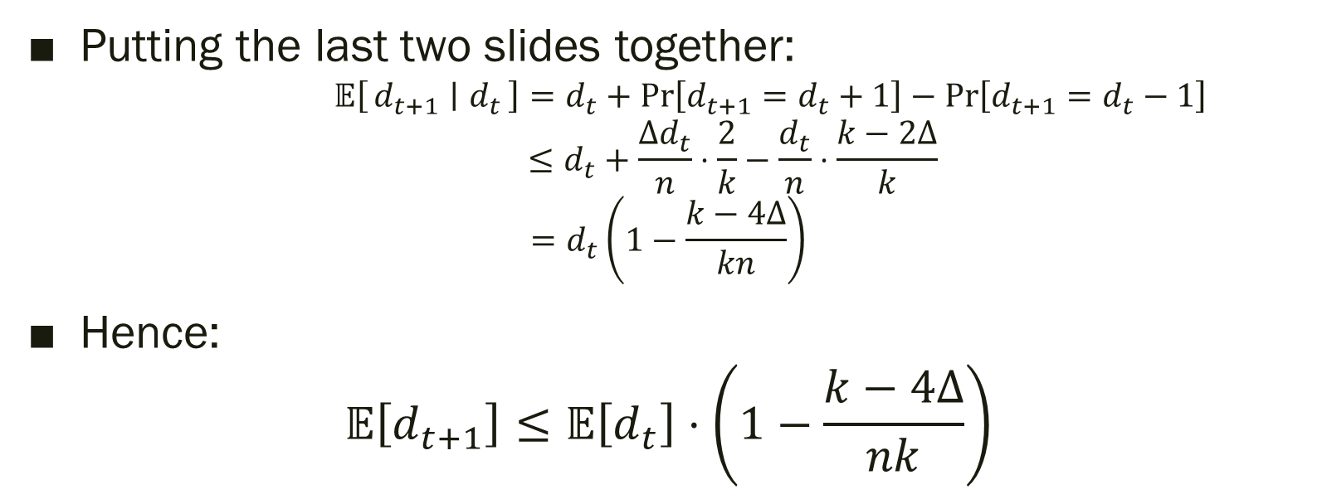
Example: Random $k$-colorings
Putting the last two slides together:
$$𝔼\left[d_{t+1} ∣ d_{t}\right]=d_{t}+\operatorname{Pr}\left[d_{t+1}=d_{t}+1\right]−\operatorname{Pr}\left[d_{t+1}=d_{t}−1\right]$$
$$≤d_{t}+\frac{Δd_{t}}{n}⋅\frac{2}{k}−\frac{d_{t}}{n}⋅\frac{k−2Δ}{k}$$
$$=d_{t}\left(1−\frac{k−4Δ}{kn}\right)$$
Hence:
$$𝔼\left[d_{t+1}\right]≤𝔼\left[d_{t}\right]⋅\left(1−\frac{k−4Δ}{nk}\right)$$

Slide 38
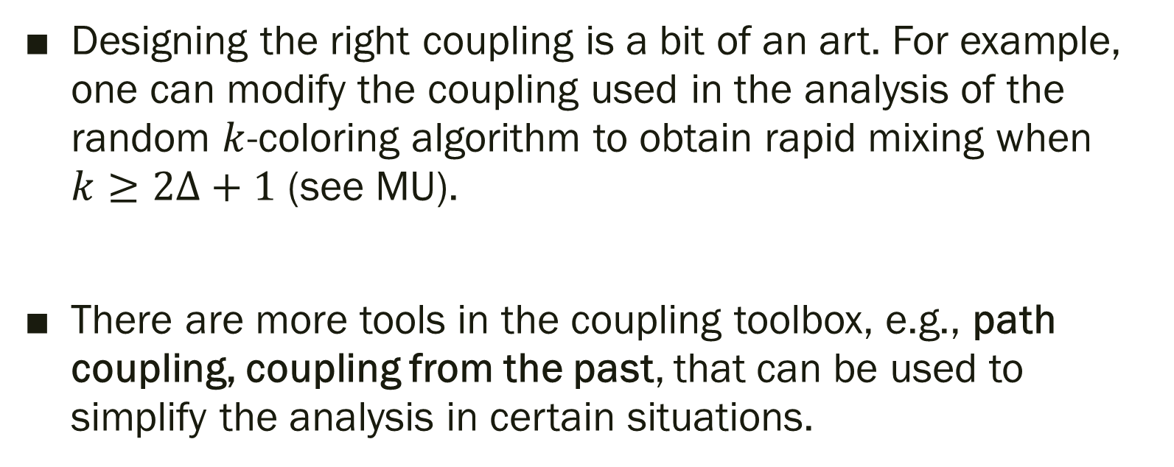
Takeaways (Coupling)
Designing the right coupling is a bit of an art. For example, one can modify the coupling used in the analysis of the random $k$-coloring algorithm to obtain rapid mixing when $k≥2Δ+1$ (see MU).
There are more tools in the coupling toolbox, e.g., path coupling, coupling from the past, that can be used to simplify the analysis in certain situations.

Slide 39
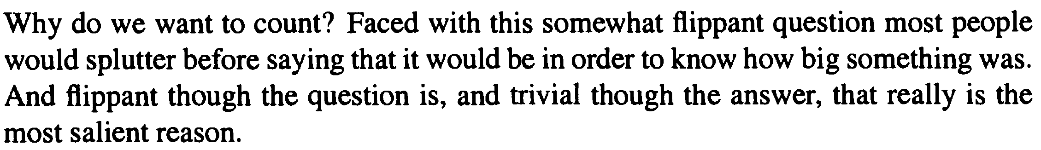
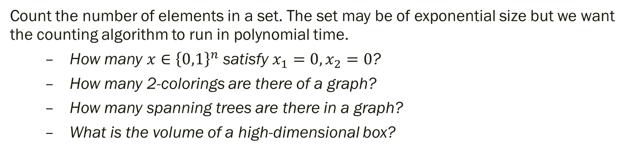
Counting
(Russ Bubley, 2001)
Count the number of elements in a set. The set may be of exponential size but we want the counting algorithm to run in polynomial time.
  How many $x∈{\left\{0,1\right\}}^{n}$ satisfy $x_{1}=0, x_{2}=0$?
  How many 2-colorings are there of a graph?
  How many spanning trees are there in a graph?
  What is the volume of a high-dimensional box?

Slide 40
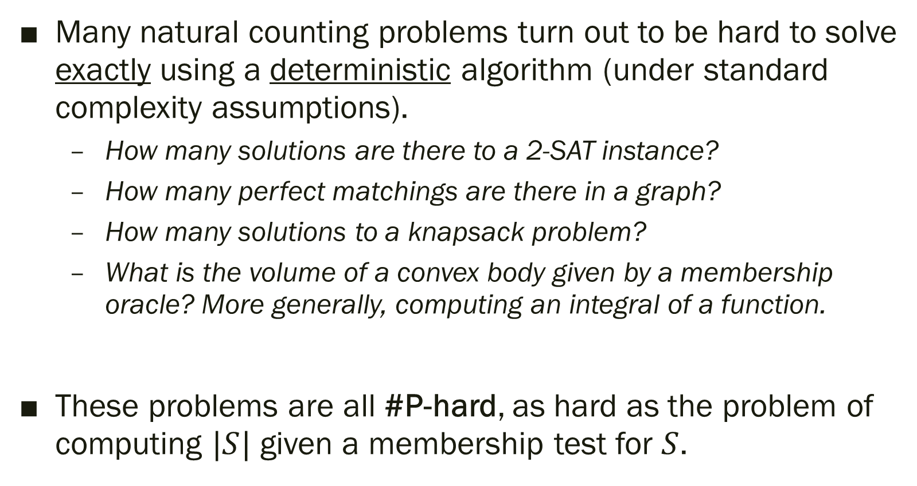
#P-hardness
Many natural counting problems turn out to be hard to solve exactly using a deterministic algorithm (under standard complexity assumptions).
  How many solutions are there to a 2-SAT instance?
  How many perfect matchings are there in a graph?
  How many solutions to a knapsack problem?
  What is the volume of a convex body given by a membership oracle? More generally, computing an integral of a function.
These problems are all #P-hard, as hard as the problem of computing $|S|$ given a membership test for $S$.

Slide 41
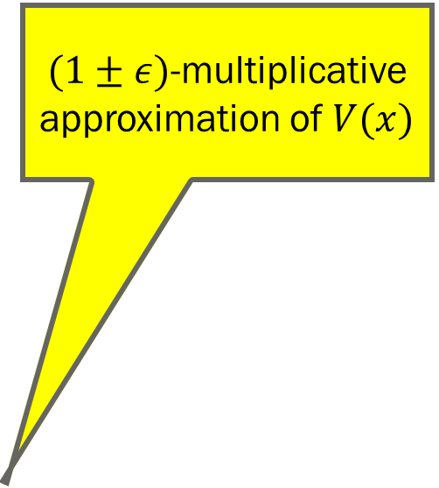
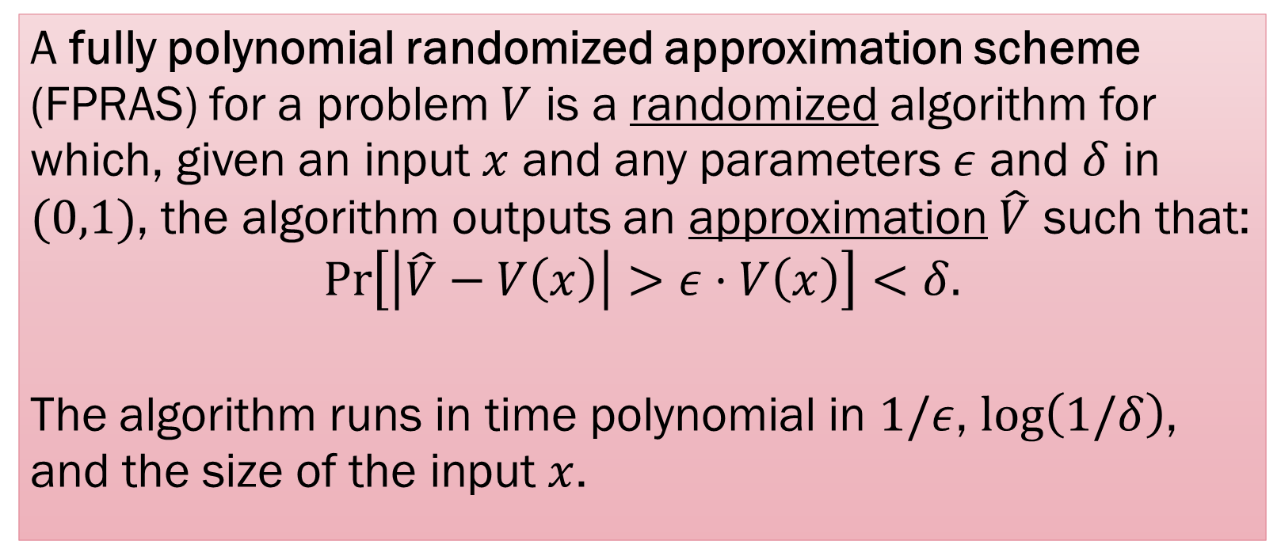
FPRAS
$(1±ε)$-multiplicative approximation of $V(x)$
A fully polynomial randomized approximation scheme (FPRAS) for a problem $V$ is a randomized algorithm for which, given an input $x$ and any parameters $ε$ and $δ$ in $(0,1)$, the algorithm outputs an approximation $\hat{V}$ such that:
$$\operatorname{Pr}\left[\left|\hat{V}−V\left(x\right)\right|>ε⋅V\left(x\right)\right]<δ.$$
The algorithm runs in time polynomial in $1/ε$, $\log\left(1/δ\right)$, and the size of the input $x$.

Slide 42
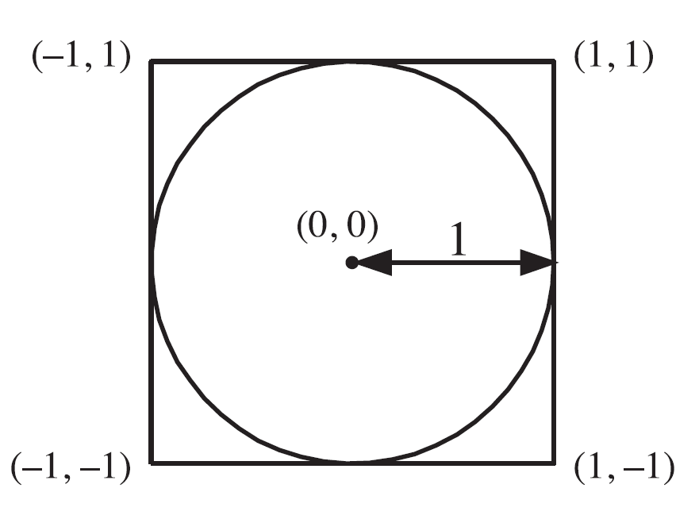
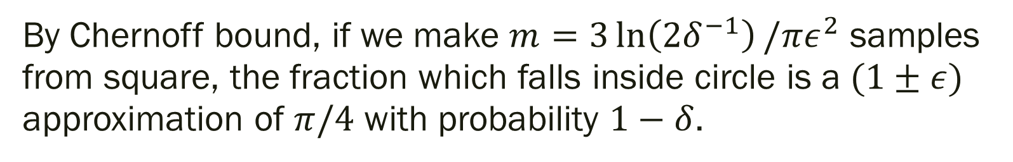
FPRAS for area estimation
By Chernoff bound, if we make $m=3\ln\left(2δ^{−1}\right)/πε^{2}$ samples from square, the fraction which falls inside circle is a $(1±ε)$ approximation of $π/4$ with probability $1−δ$.

Slide 43
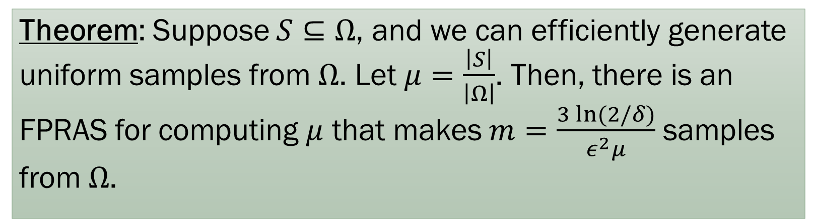
FPRAS for size estimation
Theorem: Suppose $S⊆Ω$, and we can efficiently generate uniform samples from $Ω$. Let $μ=\frac{\left|S\right|}{\left|Ω\right|}$. Then, there is an FPRAS for computing $μ$ that makes $m=\frac{3 ln⁡(2/δ)}{ε^{2}μ}$ samples from $Ω$.
Somewhat paradoxically, situation is worse for smaller $S$.

Slide 44
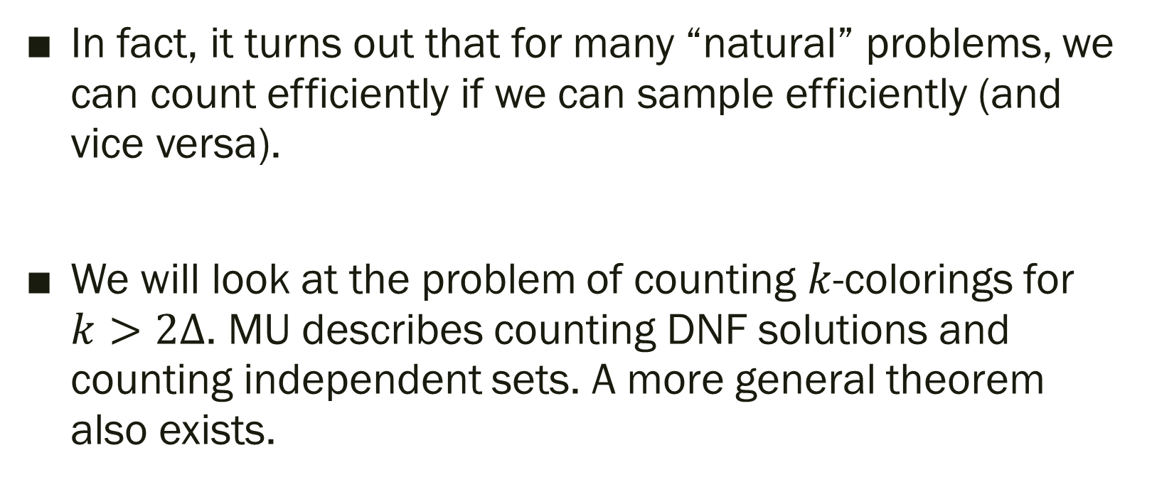
Relationship between Sampling & Counting
In fact, it turns out that for many “natural” problems, we can count efficiently if we can sample efficiently (and vice versa).
We will look at the problem of counting $k$-colorings for $k>2Δ$. MU describes counting DNF solutions and counting independent sets. A more general theorem also exists.

Slide 45


FPAUS
Suppose $Ω(x)$ is the sample space associated with an input $x$ (e.g., set of $k$-colorings of a graph).
A sampling algorithm is a fully polynomial almost uniform sampler (FPAUS) if, given an input $x$ and a parameter $ε>0$, its output distribution $W(x)$ satisfies:
$$||W\left(x\right)−U(x)||≤ε$$
where $U(x)$ is the uniform distribution on $Ω(x)$. It runs in time polynomial in $1/ε$ and the size of the input $x$.

Slide 46


FPAUS to FPRAS: $k$-coloring
Let $G$ be the input graph with $n$ vertices and $m$ edges.
Order the edges $e_{1},e_{2},…, e_{m}$. Let $G_{i}$ be the graph on all $n$ vertices and edges $\{e_{1},…, e_{i}\}$.
Let $C_{i}$ be the number of $k$-colorings for $G_{i}$. Note $C_{m}$ is what we want, and $C_{0}=k^{n}$.
$C_{m}=\frac{C_{m}}{C_{m−1}}×\frac{C_{m−1}}{C_{m−2}}×⋯×\frac{C_{1}}{C_{0}}×C_{0}$. Let’s try to approximate each $\frac{C_{i}}{C_{i−1}}$.

Slide 47


FPAUS to FPRAS: $k$-coloring
Lemma: Suppose $k>2Δ$. Then, given a FPAUS for sampling $k$-colorings from input graphs, then there is a FPRAS for computing $\frac{C_{i}}{C_{i−1}}$ for each $1≤i≤m$.
Estimate each $C_{i}/C_{i−1}$ upto multiplicative error $\left(1±\frac{ε}{2m}\right)$ with probability $1−\frac{δ}{m}$. Then, by union bound, with probability at least $1−δ$, each $C_{i}/C_{i−1}$ computed upto multiplicative error $\left(1±\frac{ε}{2m}\right)$. Multiplying these estimates approximates $\prod_{i=1}^{m}{C_{i}/C_{i−1}}$with multiplicative error $\left(1±ε\right)$. This yields an FPRAS for $C_{m}$.

Slide 48


FPAUS to FPRAS: $k$-coloring
Lemma: Suppose $k>2Δ$. Then, given a FPAUS for sampling $k$-colorings from input graphs, then there is a FPRAS for computing $\frac{C_{i}}{C_{i−1}}$ for each $1≤i≤m$.
Idea: Use FPAUS to generate several random $k$-colorings in $G_{i−1}$, and check how many are also proper $k$-colorings for $G_{i}$.
Why does this work? We’ll show that $\frac{C_{i}}{C_{i−1}}≥\frac{3}{4}$.
Two sources of error:
  Approximate Sampler: Output distribution of FPAUS is approximately uniform
  Finite Sample Error: Enough $k$-colorings of $G_{i−1}$ need to be sampled so that we obtain a good estimate of $C_{i}/C_{i−1}$.

Slide 49


FPAUS to FPRAS: $k$-coloring
Claim: If $k>2Δ$,
$$\frac{C_{i}}{C_{i−1}}≥\frac{3}{4}$$
Suppose the $i$’th edge is $(u,v)$.
For any coloring of $G_{i−1}$ that is not a coloring of $G_{i}$, you can obtain a coloring of $G_{i}$ by recoloring $u$ to any of the allowed $k−Δ≥Δ+1$ colors.
So, $C_{i}≥\left(Δ+1\right)\left(C_{i−1}−C_{i}\right)$, and $\frac{C_{i}}{C_{i−1}}≥\frac{Δ+1}{Δ+2}≥\frac{3}{4}$

Slide 50

FPAUS to FPRAS: $k$-coloring
Suppose FPAUS on $G_{i−1}$ returns a coloring $A$ whose distribution is $ε/8m$-far from uniform in TV distance:
$$\left|\operatorname{Pr}\left[A \text{colors} G_{i}\right]−\frac{C_{i}}{C_{i−1}}\right|≤\frac{ε}{8m}$$
If we sample $r$ colorings from FPAUS on $G_{i−1}$, let $Z_{i}$ be how many properly color $G_{i}$. From above:
$$\frac{rC_{i}}{C_{i−1}}\left(1−\frac{ε}{6m}\right)≤r⋅\left(\frac{C_{i}}{C_{i−1}}−\frac{ε}{8m}\right)≤𝔼\left[Z_{i}\right]≤r⋅\left(\frac{C_{i}}{C_{i−1}}+\frac{ε}{8m}\right)≤\frac{rC_{i}}{C_{i−1}}⋅\left(1+\frac{ε}{6m}\right)$$

Slide 51

FPAUS to FPRAS: $k$-coloring
$𝔼\left[Z_{i}\right]≥\frac{r}{2}$.
By Chernoff bound, using $r=(m^{2}ε^{−2}\log\left(mδ^{−1}\right))$ samples, with probability $1−δ/m$, we can get a $\left(1±\frac{ε}{6m}\right)$-multiplicative approximation of $Z_{i}$.
Hence, we get a ${\left(1±\frac{ε}{6m}\right)}^{2}⊆\left(1±\frac{ε}{2m}\right)$ multiplicative approximation of $\frac{C_{i}}{C_{i−1}}$.

Slide 52

Takeaways (Counting)
Intimate connection between sampling and counting. What we saw is an example of a general paradigm that reduces a counting problem to a sampling problem. This works for any problem having a “downward self-reducibility” property.
Another prominent success story of this line of work is volume estimation of convex bodies. Can reduce to sampling uniformly from convex bodies.

